Slide 1



《Modeling and Analysis of system》 —review chenbo2008@ustc.edu.cn

Slide 2
Course Slides
章节 | 内容
第一部分 建模基础 | 信息物理融合系统、建模、模型驱动框架
 | 安全攸关系统/实时与嵌入式系统
第二部分 需求建模 | 软件系统的需求建模（消息、用例等）
 | 软件系统的需求建模（静态结构）
 | 软件系统的需求建模（动态行为）
第三部分 系统设计 | 用于系统开发的面向对象快速开发过程
第四部分 高级建模概念 | 实时系统建模与分析语言（MARTE）
 | 实时系统与编程语言（Ada/JAVA等）

Slide 3

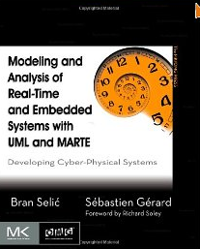
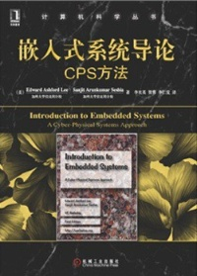
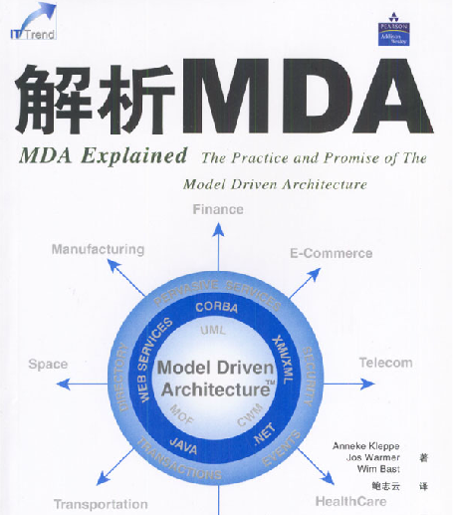
References
Grading ：
Homework and Exercises ...................................20%
Mid-Term Exam...................................................10% in class.
Final Exam………………………………............... 70%

Slide 4
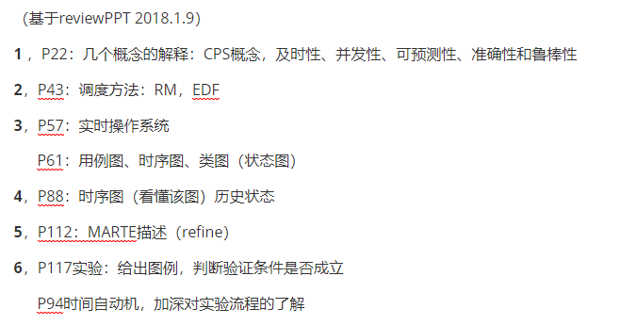
Introduction （期末部分考点，另外的考点在本ppt上有标注）

Slide 5
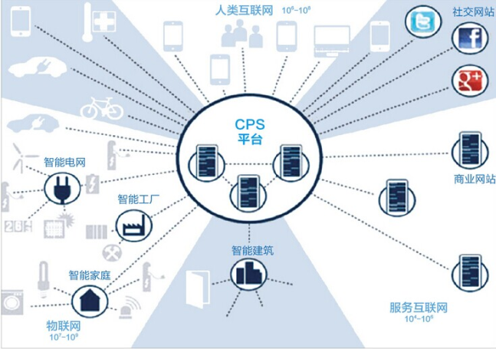
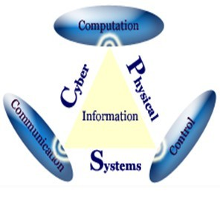
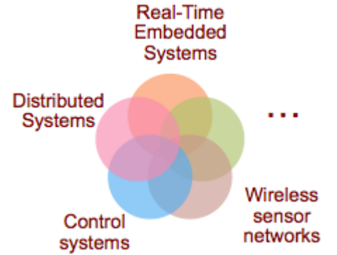
What are Cyber-Physical Systems?
Cyber – computation, communication, and control that are discrete, logical, and switched;
Physical – natural and human-made systems governed by the laws of physics and operating in continuous time;
Cyber-Physical Systems – systems in which the cyber and physical systems are tightly integrated at all scales and levels;
“CPS will transform how we interact with the physical world just like the Internet transformed how we interact with one another.”

Slide 6
Characteristics of Cyber-Physical Systems
Some defining characteristics:
Cyber – physical coupling driven by new demands and applications
Cyber capability in every physical component
Large scale wired and wireless networking
Networked at multiple and extreme scales
Systems of systems
New spatial-temporal constraints
Complex at multiple temporal and spatial scales
Dynamically reorganizing/reconfiguring
Unconventional computational and physical substrates (Bio? Nano?)
Novel interactions between communications/computing/control
High degrees of automation, control loops must close at all scales
Large numbers of non-technical savvy users in the control loop
Ubiquity drives unprecedented security and privacy needs
Operation must be dependable, certified in some cases

Slide 7
Characteristics of Cyber-Physical Systems
What they are not:
Not desktop computing
Not traditional, post-hoc embedded/real-time systems
Not today’s sensor nets
Goals of a CPS research program
A new science for future engineered and monitored/controlled physical systems (10-20 year perspective)
Physical and cyber (computing, communication, control) design that is deeply integrated

Slide 8
Application Domains of Cyber-Physical Systems
Healthcare
Medical devices
Health management networks
Transportation
Automotive electronics
Vehicular networks and smart highways
Aviation and airspace management
Avionics
Railroad systems
Process control
Large-scale Infrastructure
Physical infrastructure monitoring and control
Electricity generation and distribution

Slide 9
Application Domains of Cyber-Physical Systems
Defense systems
Tele-physical operations
Telemedicine
Tele-manipulation

Slide 10
Model-Drive Development

Slide 11
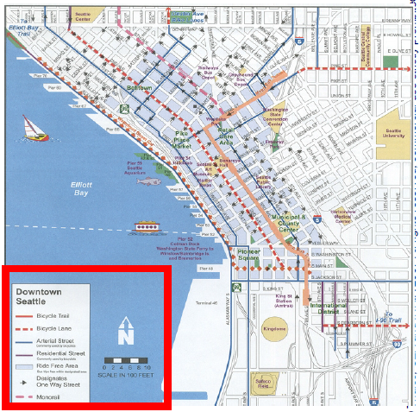
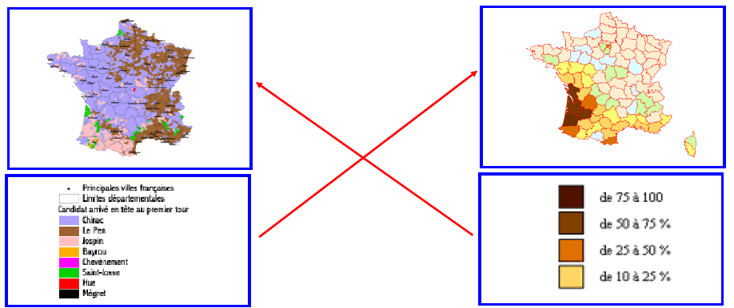
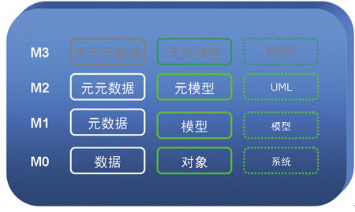
Modeling
A reduced/abstract representation of some system that highlights the properties of interest from a given point of view.
The point of view defines concern and scope of the model.
元模型

Slide 12
Modeling
Phil Bernstein, "A Vision for Management of Complex Systems".
A model is a complex structure that represents a design artifcat such as a relateional schema,an interface definition(API),an XML schema, a semantic network,a UML model or a hypermedia document.
OMG,"UML Superstructure".
A model captures a view of a physical system. It is an abstraction of the physical system,with a certain purpose. This purpose determines what is included in the model and what is relevant. thus the model completely describes those aspects of the physical system that are relevant to the purpose of the model, at the appropriate level of detail.
OMG,"MDA Guide"
a formal specification of the function,structure and/or behavior of an application or system.
Steve Mellor,et al.,"UML Distilled"
A model is a simplification of something so we can view.manipulate, and reason about it, and so help us understand the complexity inherent in the subject under study.
Anneke Kleppe,et.al."MDA Explained"
A model is a description of(part of) a system written in a well-defined language. A well-definied language is a language with well-defined form(syntax), and meaning(semantics). which is suitable for automated interpretation by a computer.
chris Raistrick et al.,"Model Driven Architecture with Executable UML"
A formal representation of the function, behavior, and structure of the system we are considering, expressed in an unambiguous language.

Slide 13
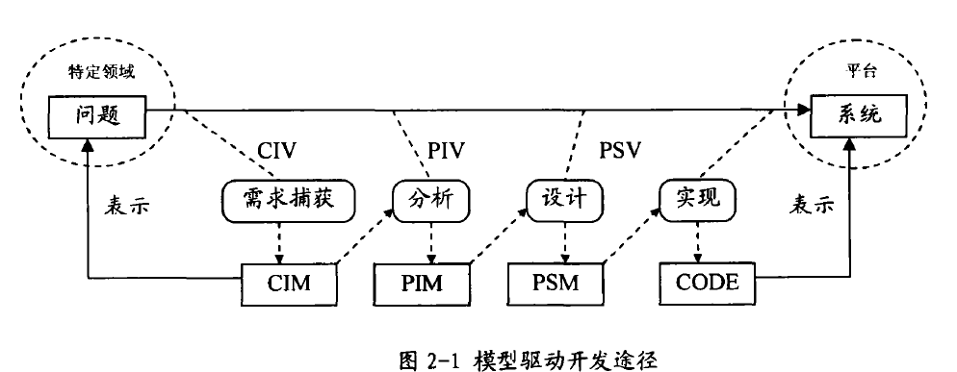
Model Driven Architecture
MDA 定义了三种模型：
计算独立模型（Computation-Independent Model，CIM）
描述系统的需求和将在其中使用系统的业务上下文。此模型通常描述系统将用于做什么，而不描述如何实现系统。CIM 通常用业务语言或领域特定语言来表示。
平台独立模型（Platform-Independent Model，PIM）
描述如何构造系统，而不涉及到用于实现模型的技术。此模型不描述用于为特定平台构建解决方案的机制。PIM 在由特定平台实现时可能是适当的，或者可能适合于多种平台上的实现。
平台特定模型（Platform-Specific Model，PSM）
从特定平台的角度描述解决方案。其中包括如何实现 CIM 和如何在特定平台上完成该实现的细节。

Slide 14
Model Driven Architecture
CIM
Computation Independent Model（CIM）
Platform Independent Model(PIM)
Platform Specific Model(PSM)
Code generation
PIM
PSM
CG

Slide 15
Model Driven Architecture

Slide 16
safety critical systems

Slide 17
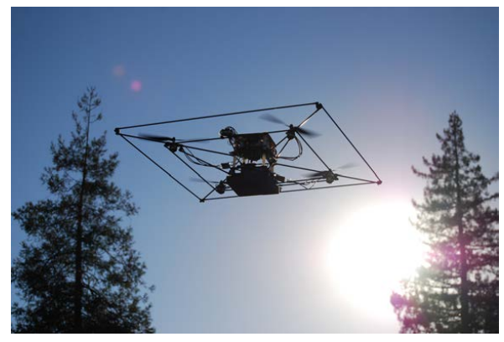
What is a Real-Time System?
Real-time systems have been defined as: "those systems in which the correctness of the system depends not only on the logical result of the computation, but also on the time at which the results are produced";
J. Stankovic, "Misconceptions About Real-Time Computing," IEEE Computer, 21(10), October 1988.

Slide 18
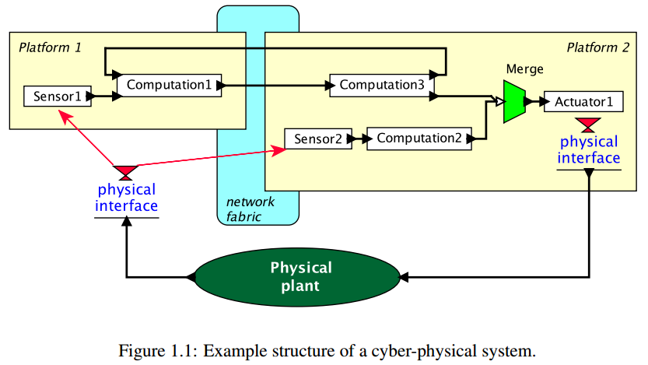
Example structure of a cyber-physical system

Slide 19
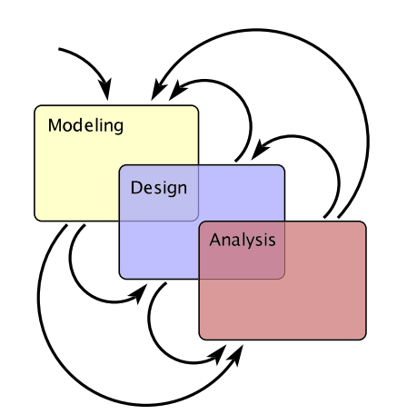
The Design Process

Slide 20
The Design Process （3）
Modeling is the process of gaining a deeper understanding of a system through imitation. Models imitate the system and reflect properties of the system. Models specify what a system does.
Design is the structured creation of artifacts. It specifies how a system does what it does.
Analysis is the process of gaining a deeper understanding of a system through dissection. It specifies why a system does what it does(or fails to do what a model says it should do).

Slide 21
Terms and concepts
Real time sysetm: is one that has performance deadlines on tis computations and actions. real time systems are often emebdded.meaning that the comptuational system exists inside a larger system, with the purpose of helping that system to achieve its overall responsibilities.
reactive or event-driven sysetm: is one whose behavior is primarily caused by specific reactions to external events rather than being self-generated.
time-driven systems: is one whose actions are driven primarily by either the passage of time or the arrival of time epochs.

Slide 22
Some Definitions（概念在课件ppt上有）
Timing constraint: constraint imposed on timing behavior of a job: hard or soft.
Release Time: Instant of time job becomes available for execution. If all jobs are released when the system begins execution, then there is said to be no release time
Deadline: Instant of time a job's execution is required to be completed. If deadline is infinity, then job has no deadline. Absolute deadline is equal to release time plus relative deadline
Response time: Length of time from release time to instant job completes.

Slide 23
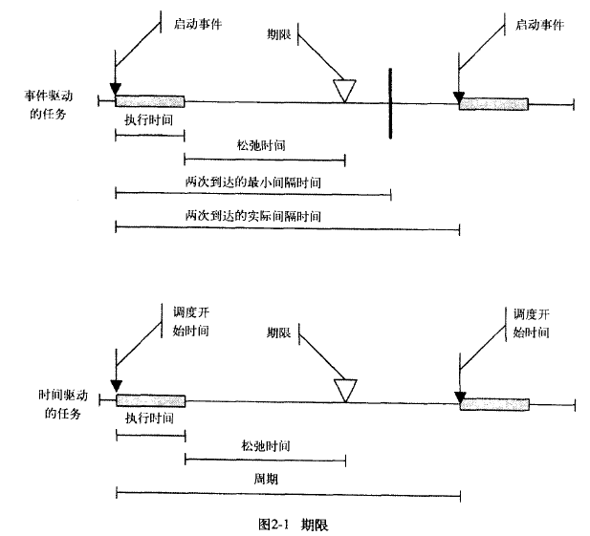
Terms and concepts

Slide 24
Timeliness
The timeliness of an action has to do with the action meeting time constraints, such as a deadline. deadline maybe hard or soft. Missing a hard deadline constitutes a system failure of some kind, so great care must be taken to ensure that all such actions execute in a timely way. The important modeling concerns of timeliness are modeling execution time, deadlines, arrival patterns, synchronization pattern and time sources.

Slide 25
Timeliness
Timeliness requirements may be addressed by first determining the end-to-end performance requirement of an event-response action sequence. these are usually determined during use case or context analysis.for example:
"When the actor Volumecontrol sens an increase command. the system shall responsed within 10 ms +/- ms"

Slide 26
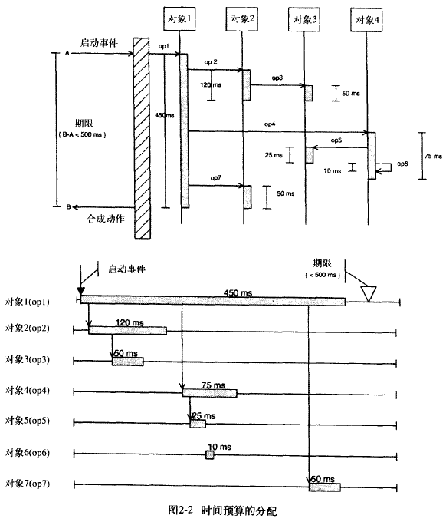
Timeliness

Slide 27
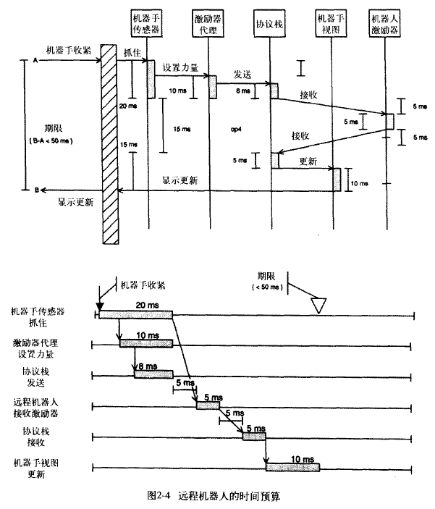
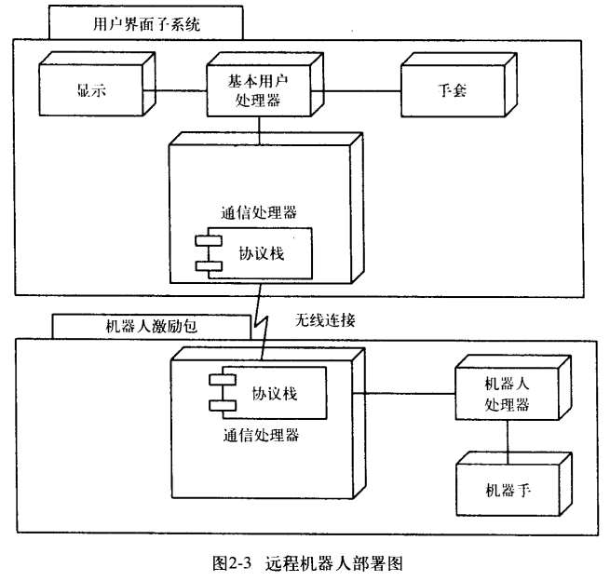
Timeliness
Remote RobotArm：

Slide 28
Concurrency
Concurrency is the simultaneous execution of multiple sequential chains of actions. These action chains may execute on one processor(pseudo-concurrency) or multiple processors(true concurrency).Issues surrounding the exectuion of concurrent systems have to do with :
the scheduling characteristics of the concurrent thread;
the arrival patterns of incoming events;
the rendezvous patterns used when threads must synchronize;
and the methods of controlling access to shared resources.

Slide 29
Predictability
A key aspect of many real time systems is their predicatbility.

Slide 30
correctness and robustness
A system is correct when it does the right thing all the time. Such a system is robust when it does the right thing under novel(unplanned) circumstances, even in the presence of unplanned failures of portions of the system. one must be on guard for deadlock, race condition, and other exceptional conditions.

Slide 31
correctness and robustness-deadlock
there are four conditions that must be true for deadlock:
task claim exclusive control over shared resources.
task hold resources while waiting for other resource to be relesed.
task connot be forced to relinquish resources.
A circular waiting condition exists.

Slide 32
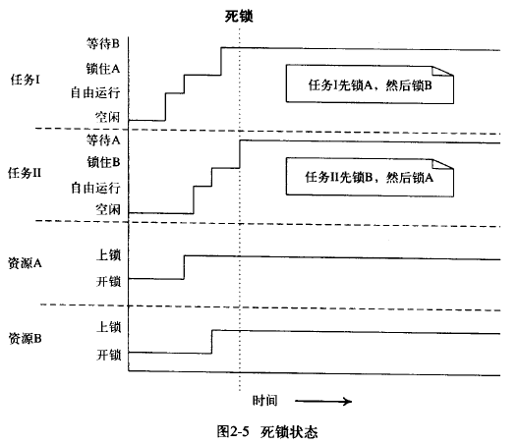
correctness and robustness-deadlock

Slide 33
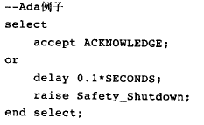
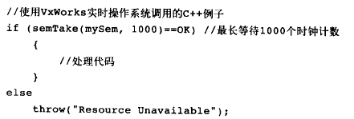
correctness and robustness-deadlock
Another way to negate condition 4 is to use a timed rendezvous. this is usually done a timed mutex from an RTOS, OR a timed entry call in Ada, as follow:

Slide 34
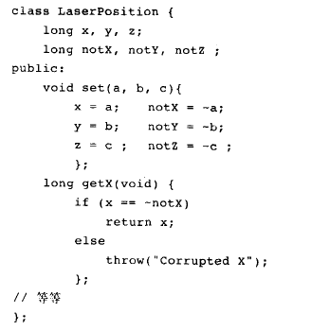
correctness and robustness-Exceptional Conditions
A robust system is one that continues todo the right thing even in the presence of system faults.

Slide 35
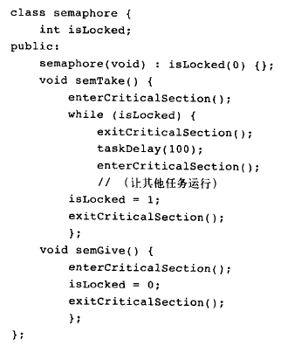
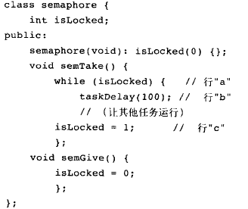
correctness and robustness-race conditions

Slide 36
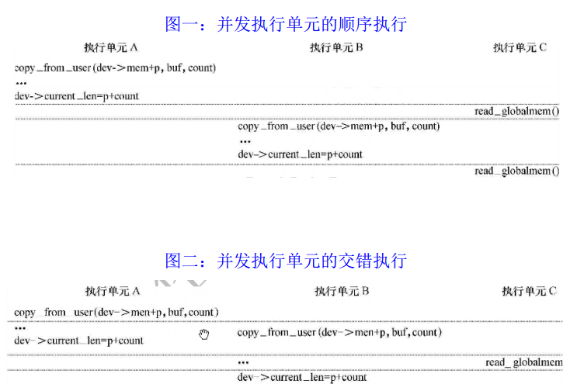
correctness and robustness-race conditions

Slide 37
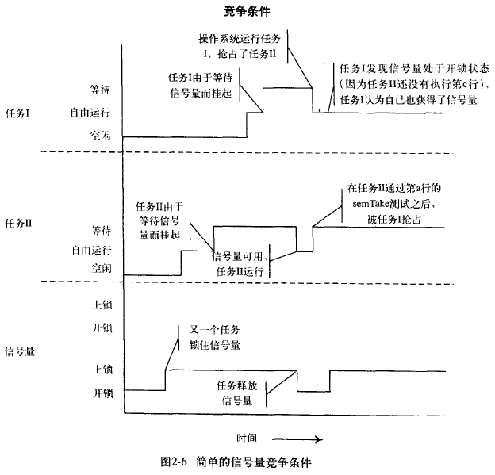
correctness and robustness-race conditions

Slide 38
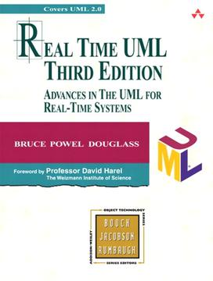
Real-time systems
Real-time scheduling algorithms
Fixed-priority algorithm (RM)
Dynamic-priority algorithm (EDF)

Slide 39
Real-time workload
Job (unit of work)
a computation, a file read, a message transmission, etc
Attributes
Resources required to make progress
Timing parameters
Absolute deadline
Released
Execution time
Relative deadline

Slide 40
Real-time task
Task : It starts with reading of input data and of its internal state and terminates with the production of the results and updates internal state.
A task that does not have an internal state at its point of invocation is called a stateless task, otherwise, it is called a statefull task.

Slide 41
Real-time task
Task : a sequence of similar jobs
Periodic task (p,e)
Its jobs repeat regularly
Period p = inter-release time (0 < p)
Execution time e = maximum execution time (0 < e < p)
Utilization U = e/p
0
5
10
15

Slide 42
Deadlines: Hard vs. Soft
Hard deadline
Disastrous or very serious consequences may occur if the deadline is missed
Validation is essential : can all the deadlines be met, even under worst-case scenario?
Deterministic guarantees
Soft deadline
Ideally, the deadline should be met for maximum performance. The performance degrades in case of deadline misses.
Best effort approaches / statistical guarantees

Slide 43
Schedulability
Property indicating whether a real-time system (a set of real-time tasks) can meet their deadlines
(4,1)
(5,2)
(7,2)

Slide 44
Real-Time Scheduling
Determines the order of real-time task executions
Static-priority scheduling
Dynamic-priority scheduling
(4,1)
(5,2)
5
10
15
(7,2)
5
10
15

Slide 45
RM (Rate Monotonic)
Optimal static-priority scheduling
It assigns priority according to period
A task with a shorter period has a higher priority
Executes a job with the shortest period
T₁
(4,1)
T₂
(5,2)
5
10
15
T₃
(7,2)
5
10
15

Slide 46
RM (Rate Monotonic)
Executes a job with the shortest period
T₁
(4,1)
T₂
(5,2)
5
10
15
T₃
(7,2)
5
10
15

Slide 47
RM (Rate Monotonic)
The original Rate Monotonic approach had several restrictions:
all tasks are independent of each other(e.g. they do not interact)
all tasks are periodic
no task can block waiting for an external event.
all tasks share a common release time(caled the critical instant)
all tasks have a deadline equal to their period.
Executes a job with the shortest period
Deadline Miss !
T₁
(4,1)
T₂
(5,2)
5
10
15
T₃
(7,2)
5
10
15

Slide 48
Response Time
The original Rate Monotonic approach had several restrictions:
all tasks are independent of each other(e.g. they do not interact)
all tasks are periodic
no task can block waiting for an external event.
all tasks share a common release time(caled the critical instant)
all tasks have a deadline equal to their period.
Response time
Duration from released time to finish time
T₁
(4,1)
T₂
(5,2)
5
10
15
T₃
(10,2)
5
10
15

Slide 49
Response Time
The original Rate Monotonic approach had several restrictions:
all tasks are independent of each other(e.g. they do not interact)
all tasks are periodic
no task can block waiting for an external event.
all tasks share a common release time(caled the critical instant)
all tasks have a deadline equal to their period.
Response time
Duration from released time to finish time
Response Time
T₁
(4,1)
T₂
(5,2)
5
10
15
T₃
(10,2)
5
10
15

Slide 50
RM – Utilization Bound
Real-time system is schedulable under RM if
∑Ui ≤ n (21/n-1)
Example: T1(4,1), T2(5,1), T3(10,1),
∑Ui = 1/4 + 1/5 + 1/10
= 0.55
3 (21/3-1) ≈ 0.78
Thus, {T1, T2, T3} is schedulable under RM.

Slide 51
EDF (Earliest Deadline First)
Optimal dynamic priority scheduling
A task with a shorter deadline has a higher priority
Executes a job with the earliest deadline
T₁
(4,1)
T₂
(5,2)
5
10
15
T₃
(7,2)
5
10
15

Slide 52
EDF (Earliest Deadline First)
Executes a job with the earliest deadline
T₁
(4,1)
T₂
(5,2)
5
10
15
T₃
(7,2)
5
10
15

Slide 53
EDF (Earliest Deadline First)
Executes a job with the earliest deadline
T₁
(4,1)
T₂
(5,2)
5
10
15
T₃
(7,2)
5
10
15

Slide 54
EDF (Earliest Deadline First)
Executes a job with the earliest deadline
T₁
(4,1)
T₂
(5,2)
5
10
15
T₃
(7,2)
5
10
15

Slide 55
EDF (Earliest Deadline First)
Optimal scheduling algorithm
if there is a schedule for a set of real-time tasks,
EDF can schedule it.
T₁
(4,1)
T₂
(5,2)
5
10
15
T₃
(7,2)
5
10
15

Slide 56
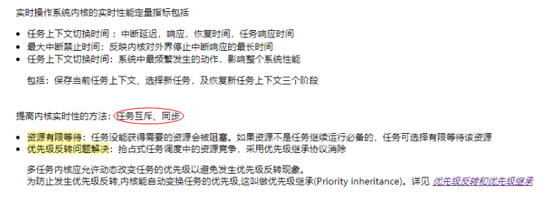
实时操作系统简介
实时操作系统－
PRET-C?
Nucleus Real Time Operating System (RTOS)?

Slide 57
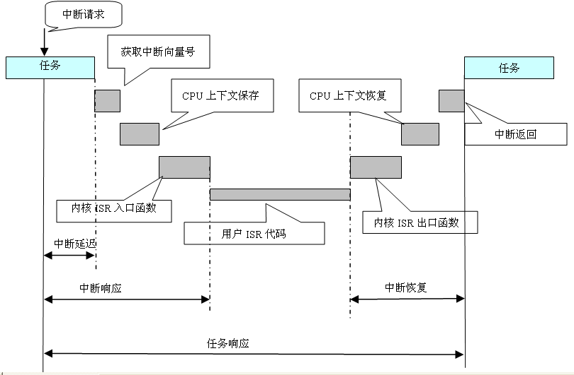
实时操作系统特点
实时操作系统内核实时性能指标
实时操作系统内核的实时性能定量指标包括：
任务上下文切换时间
中断延迟时间
中断响应时间
中断恢复时间
任务响应时间

Slide 58
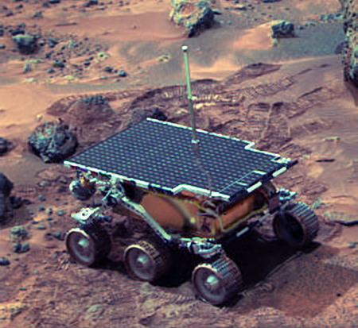
实时操作系统特点
提高内核实时性的方法－任务互斥、同步
资源有限等待：任务没能获得需要的资源会被阻塞。如果资源不是任务继续运行必备的，任务可选择有限等待该资源。
优先级反转问题解决—抢占式任务调度中的资源竞争：
1997年7月4日，火星探路者在火星表面成功着陆并进行观测，发回了各种火星表面全景图，被宣称为“完美”。但是在着陆后的第10天，也就是开始采集气象资料后不久，探路者开始出错，反复无规律地重启，每次重启都造成了数据丢失.JPL（美国国家航空航天局喷气推进实验室）的工程师们花了相当多的时间在实验室仿真，希望能够再现引起重启的情况。几天过去了，一个清晨，火星上那台探路者兄弟身上发生的重启情况终于被再现了。经过数据分析，得出了原因——优先级逆转。

Slide 59
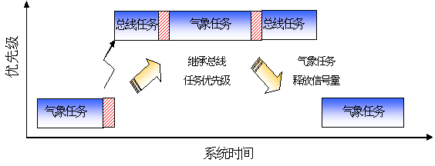
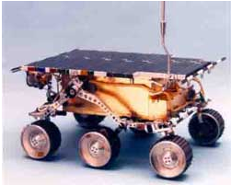
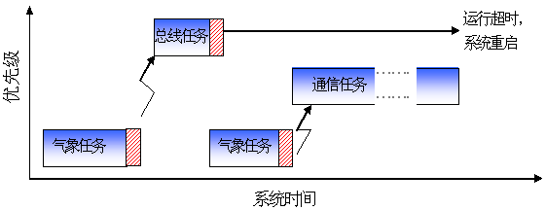
实时操作系统特点
提高内核实时性的方法——优先级反转问题
实时操作系统——优先级逆转现象
多任务内核应允许动态改变任务的优先级以避免发生优先级反转现象。为防止发生优先级反转,内核能自动变换任务的优先级,这叫做优先级继承(Priority inheritance)
采用优先级继承协议消除

Slide 60
Overview: modeling with UML
What is modeling and requirement Model?
UML and Use Case
How do we describe structure using UML?
Advanced Structure Aspect

Slide 61
UML: First Pass
Use case diagrams
Describe the functional behavior of the system as seen by the user
Class diagrams
Describe the static structure of the system: Objects, attributes, associations
Sequence diagrams
Describe the dynamic behavior between objects of the system
State diagrams
Describe the dynamic behavior of an individual object
Notes:
Statechart diagrams
Describe the dynamic behavior of an individual object (essentially a finite state automaton)
Activity Diagrams
Model the dynamic behavior of a system, in particular the workflow (essentially a flowchart)

Slide 62
UML first pass: Use case diagrams
Classifier
Use Case
Actor
System boundary
Use case diagrams represent the functionality of the system
from user’s point of view

Slide 63
UML first pass: Class diagrams
Association
Class
Multiplicity
SimpleWatch
1
1
1
1
2
1
2
1
PushButton
Display
Battery
Time
Class diagrams represent the structure of the system

Slide 64
UML first pass: Class diagrams
Class diagrams represent the structure of the system
Association
Class
Multiplicity
Watch
1
1
1
1
2
1
2
1
PushButton
state
LCDDisplay
Battery
Load
Time
Now
push() release()
blinkIdx
blinkSeconds()
blinkMinutes()
blinkHours()
stopBlinking()
referesh()
Operations
Attribute

Slide 65
UML first pass: Sequence diagram
Actor
Message
Object
Lifeline
:WatchUser
:Watch
:LCDDisplay
:Time
pressButton1()
blinkHours()
pressButton1()
blinkMinutes()
pressButton2()
incrementMinutes()
refresh()
pressButton1and2()
commitNewTime()
stopBlinking()
Activation
Sequence diagrams represent the behavior of a system
as messages (“interactions”) between different objects

Slide 66
UML first pass: Statechart diagrams
Event
Initial state
button1&2Pressed
button2Pressed
Blink
Increment
Hours
Hours
Transition
button1Pressed
button1&2Pressed
Blink
button2Pressed
Increment
State
Minutes
Minutes
button1Pressed
button2Pressed
Stop
Blink
Increment
Blinking
Seconds
Seconds
Final state
Represent behavior of a single object with interesting dynamic behavior.
Notes:
Represent behavior of single objects with interesting dynamic behavior in terms of states and transitions
The behavior of the single object Watch, for example, has several different interesting states, BlinkHours, BlinkMinutes, BlinkSeconds,
Because in each state pressing a button or two yields a different result.

Slide 67
modeling with UML

Slide 68
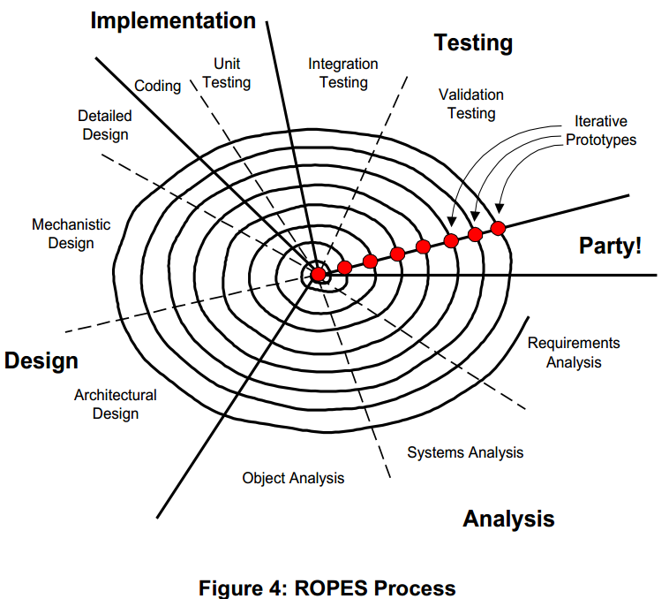
Overview: modeling with UML

Slide 69
Notations and Concepts Discussed
Advantages of Objects Structured Classes Packages
Interfaces and Ports Stereotypes Components
Architecture Classes and Objects Constraints
Subsystems Relations Tags

Slide 70
Small things:Objects, Classes, and Interfaces
Attributes(data)
Behavior(operations or methods)
States(memory)
Identity
Responsibilities
Attributes | Behavior | State | Identity | Responsibility
Linear value Rate of change (RoC) | Acquire Report Reset Zero Enable Disable | Last value Last RoC(computed value) | Instance for robot arm joint | Provide information for the precise location of the end of the robot arm with respect to some reference coordinate frame

Slide 71
Small things:Objects, Classes, and Interfaces
Attribute
Operations and Methods
Data Structure | Attributes | Operations
Stack | TopOfStack: int Size: int Element: DATA | Push Pop Full Empty
Queue | Head: int Tail: int Size: int Element: DATA | Insert Remove Full Empty
Linked List | Next: Node pointer Previous: Node pointer Element: DATA | Insert Remove Next Previous
Tree | Left: Node pointer Right: Node pointer Element: DATA | Insert Remove Next Previous

Slide 72
Overview: modeling with Dynamic Behavior
Types of behaviors
states Diagrams
Activity Diagrams
sequence diagrams

Slide 73
Behavior and the UML
other Non-functional constraints frequently apply, as well. such constraints are refered to as QOS constraints. and quality how that behavior is accomplished. For example: how long should an action take?Is two-digit accuracy enough?
QOS constraints are generally modeled using a constraint language. (OCL)

Slide 74
Behavior and the Single Object
The primary feature of the UML is its support for finite state machines.
The two fundamental concepts of statecharts are State and Transition.
A State is a condition of existence of an instance that is distinguishable from other such conditions.
States that are disjoint are called or-states because the object must be in one such state or another.

Slide 75
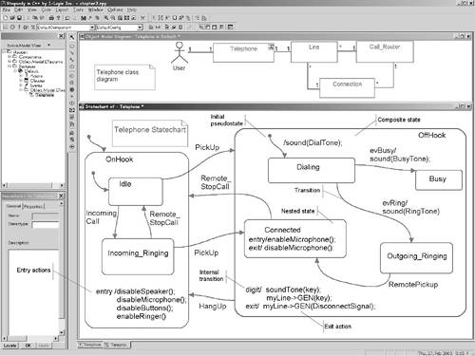
Basic Statechart Elements
Notes:
Figure 3-2 shows a simple class diagram for a PBX telephone system. We see that Telephones associate with Lines, which in turn associate with Connections and Call Routers. The lower part of the figure shows the statechart for the relatively simple class Telephone.

Slide 76
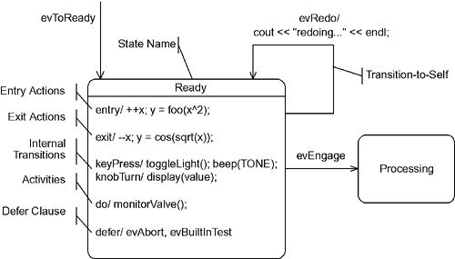
State Features（考点：执行evRedo之后的action执行顺序）
The object may execute actions when a state is entered or exited, when an event is received (although a transition isn't taken), or when a transition is taken.

Slide 77
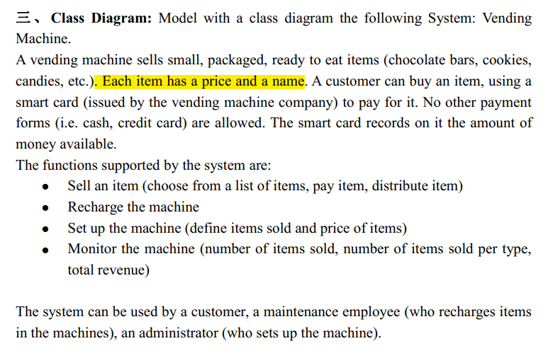
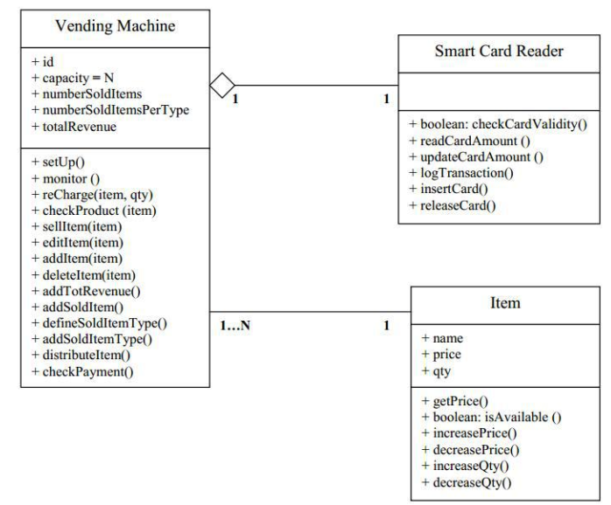

Slide 78
Transitions
Transitions are directed arcs beginning at the starting state and finishing at the target state. Transitions usually have named event triggers optionally followed by actions (i.e., executable statements or operations) that are executed when the transition is taken. The event signature for a transition is of the form:
event-name '(' parameter-list ')' '[' guard-expression ']' '/' action-list
Events may specify formal parameter lists, meaning that events may carry actual parameters.
digit(key: keyType)/ show(key)

Slide 79
Guards & Action Execution Order
The guard expression is a Boolean expression, enclosed between square brackets, that must evaluate to either true or false.
The order of execution of actions is important. The basic rule is exit-transition-entry. That is, the exit action of the predecessor state is executed first, followed by the actions on the transition, followed by the entry actions of the subsequent state.

Slide 80
Guards & Action Execution Order
1、IncomingRinging exit actions
2、On Hook exit actions
3、Pick up transition actions
4、Off Hook entry actions
5、Connected entry actions
Notes:
Figure 3-2 shows a simple class diagram for a PBX telephone system. We see that Telephones associate with Lines, which in turn associate with Connections and Call Routers. The lower part of the figure shows the statechart for the relatively simple class Telephone.

Slide 81
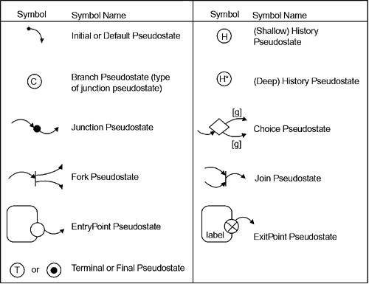
Pseudostates

Slide 82
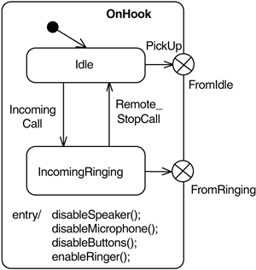
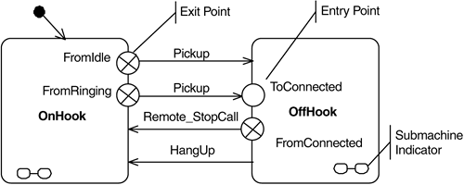
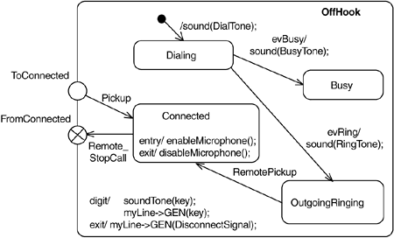
Submachines, Entry, and Exit Points

Slide 83
Activity Diagrams（考点：活动图和状态图的区别）
Activity diagrams in UML 1.x were semantically equivalent to statecharts and shared a common metamodel. In UML 2.0, activity diagrams are given their own semantic basis independent from statecharts. In UML 2.0, there are multiple levels of activity diagrams: basic, intermediate, complete, and so on.

Slide 84
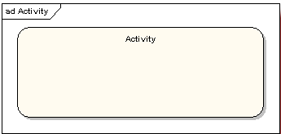
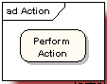
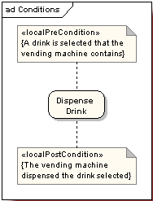
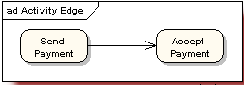
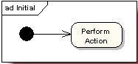
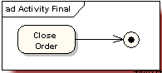
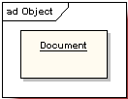
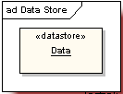


Activity Diagrams
Activity Diagram Element
1、活动状态图（Activity）
2、动作状态（Actions)
3、动作状态约束（Action Constraints）
4、动作流（Control Flow）
5、开始节点（Initial Node）
6、终止节点（Final Node）
7、对象（Objects）
8、数据存储对象（DataStore）
9、对象流（Object Flows）
10、分支与合并（Decision and Merge Nodes）
11、分叉与汇合（Fork and Join Nodes）
12、异常处理（Exception Handler）
13、活动中断区域（Interruptible Activity Region）
14、泳道（Partition）

Slide 85

Activity Diagrams

Slide 86
Interactions
There are three primary diagrammatic forms in the UML for depicting interaction scenarios—
communication diagrams,
sequence diagrams
timing diagrams.

Slide 87


Sequence Diagrams

Slide 88

Sequence Diagrams-Partial Ordering
m0.send()->m0.receive()
m1.send()->m1.receive()
m2.send()->m2.receive()
m3.send()->m3.receive()
m4.send()->m4.receive()
m5.send()->m5.receive()
对象2上的动作顺序：m1.receive->m2.receive()->m3.receive()->m4.send()->m5.send()
对象1上的动作顺序：m0.receive()->m3.send()->m5.receive()
If m2.receive() arrives prior to m0.receive(), this is called message overtaking（超车，超过，赶上）.

Slide 89

Exercise
1、What is the difference between deep and shallow history? How are they indicated? 深层和浅层历史有什么区别？ 它们如何表明？
2、The events on the signal object are fully ordered. Furthermore, messages on sequence diagrams are only partially ordered (a topic discussed shortly), in many cases the relative timing between messages is not specified.
What the partially ordered can be determined of sequence diagram shown in Finger above?
What problem might be happen with distribution of objects across multiple processors and physical locations?

Slide 90




Slide 91

Sequence Diagrams-Partial Ordering

Slide 92

Sequence Diagrams-Alternatives, Branches, Options, and Loops
There are several operators devoted to branching: alt, break, opt, and loop.

Slide 93




Timing Diagrams

Slide 94
Timed automata
Timed automata is a theory for modeling and verification of real time systems. Examples of other formalisms with the same purpose, are timed Petri Nets, timed process algebras, and real time logics.
several model checkers have been developed with timed automata being the core of their input languages e.g.. It is fair to say that they have been the driving force for the application and development of the theory.

Slide 95
Timed automata
A timed automaton is essentially a finite automaton (that is a graph containing a finite set of nodes or locations and a finite set of labeled edges) extended with real-valued variables(Timed Systems).
The variables model the logical clocks in the system, that are initialized with zero when the system is started, and then increase synchronously with the same rate.
Clock constraints i.e. guards on edges are used to restrict the behavior of the automaton.
A transition represented by an edge can be taken when the clocks values satisfy the guard labeled on the edge. Clocks may be reset to zero when a transition is taken.

Slide 96

Timed automata

Slide 97



Timed automata-Formal Syntax（语法）
Assume a finite set of real-valued variables ranged over by etc. standing for clocks and a finite alphabet ranged over by etc.standing for actions.

Slide 98


Timed automata-tools-Uppaal-Modeling with UPPAAL

Slide 99

Timed automata-tools-Uppaal-Modeling with UPPAAL

Slide 100

Timed automata-tools-Uppaal-Modeling with UPPAAL

Slide 101



Timed automata-Product Automaton
Depends on the semantics
Synchronous
Asynchronous
Explicit Synchronous

Slide 102



Timed automata-Example

Slide 103

Timed automata-Example

Slide 104

Timed automata-Example

Slide 105

UML Profile（考点：Profile优点）
A UML profile is a facility for augmenting UML models with supplementary information. This mechanism can be used in either of two ways:
1. It can be used to extend the UML language. For example, UML does not provide an explicit semaphore concept, but it is possible to add it by overloading an existing UML concept, such as Class. The result is a special kind of Class that, in addition to its standard Class semantics, incorporates semaphore semantics.
2. It can be used to attach additional information to models needed for ancillary purposes such as model analyses or code generation. Such an annotation can be used, for instance, to specify the worst-case execution time of some operation of a class, which might be needed for analyzing the timing characteristics of an application.

Slide 106

UML Profile
In this particular example, we can conclude based on the annotations that the CPU time required to execute this behavior fragment is equal to (20 microseconds + 500 microseconds) = 520 microseconds.

Slide 107

UML Profile
TimedObservation is an abstract superclass of TimedInstantObservation and TimedDurationObservation. A TimedInstantObservation denotes an instant in time, associated with an event occurrence (eocc property) and observed on a given clock.

Slide 108

Design Phase

Slide 109

Overview
The three categories are described in greater detail in Table:

Slide 110

www.omgmarte.org
MARTE Tutorial
An OMG standard:
UML profile to develop Real-Time systems

Slide 111




How to read this tutorial
www.omgmarte.org
▪ Within slides, we may shown models at different levels
of abstraction. We will clarify each level through following
pictograms
• For Domain View level
• For UML Profile View Level
• For User Model View Level
3

Slide 112
Agenda
www.omgmarte.org
▪
Part 1
•
Introduction to MDD for RT/E systems & MARTE in a nutshell
▪
Part 2
•
•
Non-functional properties modeling
Outline of the Value Specification Language (VSL)
▪
Part 3
•
The timing model
▪
Part 4
•
A component model for RT/E
▪
Part 5
•
Platform modeling
▪
Part 6
•
Repetitive structure modeling
▪
Part 7
•
Model-based analysis for RT/E
▪
Part 8
•
MARTE and AADL
▪
Part 9
•
Conclusions
4

Slide 113
A Bit of Modern Software…
www.omgmarte.org
SC_MODULE(producer) {
sc_outmaster<int> out1;
sc_in<bool> start; // kick-start
void generate_data () {
for(int i =0; i <10; i++) {
out1 =i ; //to invoke slave;
}
}
SC_CTOR(producer) {
SC_MODULE(consumer) {
sc_inslave<int> in1;
int sum; // state variable
void accumulate (){
sum += in1;
cout << “Sum = “ << sum << endl;
}
SC_CTOR(consumer) {
SC_SLAVE(accumulate, in1);
sum = 0; // initialize
SC_METHOD(generate_data);
sensitive << start;
}
};
SC_MODULE(top) { // container
producer *A1;
consumer *B1;
sc_link_mp<int> link1;
SC_CTOR(top) {
A1 = new producer(“A1”);
}
};
A1.out1(link1);
B1 = new consumer(“B1”);
B1.in1(link1);
Can you spot the architecture?
}
};
(Extracted from B. Selic presentation during Summer School MDD For DRES 2004 (Brest, September 2004)
13

Slide 114
and its UML Model
www.omgmarte.org
«sc_link_mp»
«sc_module»
producer
link1
«sc_module»
consumer
Can you spot the architecture?
(Extracted from B. Selic presentation during Summer School MDD For DRES 2004 (Brest, September 2004)
14

Slide 115

Model Evolution: Refinement（考refinement定义）
www.omgmarte.org
void generate_data(){
«sc_module»
producer
producer
for (int i=0; i<10; i++){
out1 = i;
}}
start
out1
NotStarted
producer
start /generate_data( )
NotStarted
Started
refine
start
St1
St2

Slide 116

Profiling UML for a Domain
www.omgmarte.org
▪ Advantages of UML Profiles
•
•
•
•
Reuse of language infrastructure (tools, specifications)
Require less language design skills
Allow for new (graphical) notation of extended stereotypes
A profile can define model viewpoints
▪ E.g., UML activity diagram extended to specify multitask behavior
▪ Disadvantage
• Constrained by UML metamodel
Extracted from S.Gerard (ECRTS07)
17

Slide 117





Design Pattern Adopted for the MARTE Profile
www.omgmarte.org
▪
Stage 1 → Description of MARTE domain models (Domain View)
•
•
Purpose:
Techniques:
Formal description of the concepts required for MARTE
Meta-modeling
▪
Stage 2 → Mapping of MARTE domain models towards UML2: ( UML Representation)
•
•
Purpose:
Techniques:
MARTE domain models design as a UML2 extensions
UML2 profile
« metamodel »
Marte domain model
« profile »
Marte profile
« refine »
UML2 metamodel
« reference »
Extracted from S.Gerard (ECRTS07)
21

Slide 118

Example: Domain model → Profile → Usage
MARTE::CoreElements::
Causality::CommonBehavior::
BehavioredClassifier
« enumeration»
CallConcurrencyKind
sequential
MARTE::GRM::ResourceTypes
::SynchResource
guarded
concurrent
services
PpUnit
RtService
{subsets pServices}
*
concPolicy: CallConcurrencyKind
memorySize: NFP_dataSize
owne r
1
behaviors
*
RtBehavior
1
« enumeration»
PoolMgtPolicyKind
CallConcurrencyKind
infiniteWait
timedWait
dynamic
exception
other
« metaclass »
CommonBehavior::
BasicBehaviors::
BehavioredClassifier
sequential
guarded
concurrent
« stereotype»
RtUnit
isDynamic: Boolean [1] = true
isMain: Boolean
« stereotype»
PpUnit
concPolicy:CallConcurrencyKind
memorySize: NFP_DataSize
poolSize: Integer
poolPolicy: PoolMgtPolicyKind
poolWaitingTime: NFP_Duration
operationalMode: Behavior
main: Operation
memorySize: NFP_DataSize
22

Slide 119

exp-1

Slide 120

exp-2

Slide 121

exp-3

Slide 122
exp-3

Slide 123
exp-4

